Slide 1


Your Technology & Integration Partner
Notes:
1

Slide 2
Topics
Who is Velocite Systems
What we do
Hardware
Software
Working together

Slide 3
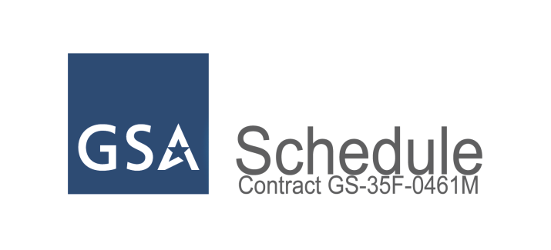
Company Overview
Premier integrator of mission-critical platforms and system solutions
Established in 1985 & reincorporated in 2001 as Velocite Systems. Small, woman owned
Headquartered in the Baltimore-Washington technology corridor
GSA schedule holder
COTS/Custom server & Linux focus

Slide 4
Core Business
Hardware/Software Design & Integration
Data Storage and IP servers
Security applications – Cyber/screening/…
Industrial servers – e.g. Telephony/signal processing/…
Military specification/NEBS/FCC
Custom platform development
Linux OS & Application Development
Embedded/Custom Kernels
VoIP/RFID/Media capture
Encryption Rekeying

Slide 5
Service Focus
Product Bundling
Turn-key applications
Loading and testing
Private label
Application Hosting
Course work and training modules
Network Monitoring/Management
Post Delivery Support
Help Desk
On-site support: 24 x 7 Hardware Support Available

Slide 6







Sample Client List
Notes:
6

Slide 7


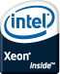

Sample COTS Products
Sample Servers
VS-6400 series
6u 8-14-20 slot rack mount enclosure
HS 1500W PS w/SATAII or SCSI RAID
Used in Telephony call center application
VS-4400 series
Dual hot-swappable 600W power supplies
Dual Quad Core
Used in Government security application

Slide 8
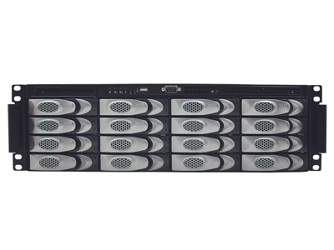
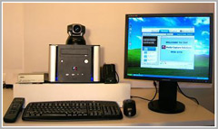
Sample Product Solutions
Digital Content Storage & Delivery System
12 to 96 TB server w/ RAID 6
Software included to fully manage and protect content
Knowledge Capture Studio
Live presentation capture
Audio, Video, Slides
OCR, Transcript support
Hardware/Software bundle or Software only
Notes:
8

Slide 9
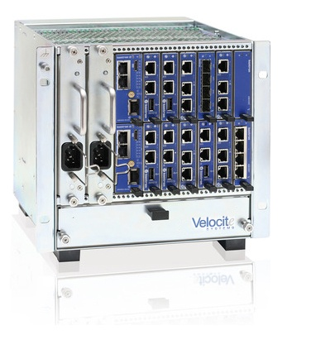

Sentry-µTCA
12 Slot Compact and Powerful Sentry-µTCA Platform
Compact System for up to 12 Mid-Size AMCs (Single-Width and Double-Width)
Dual Pluggable AC PSUs
Dual-Star backplane incl. GbE, 10GbE, PCIe and SRIO according to SCOPE mapping
Management Options: Fully Featured MCH with various fabric options; one or two MCHs
And more...

Slide 10
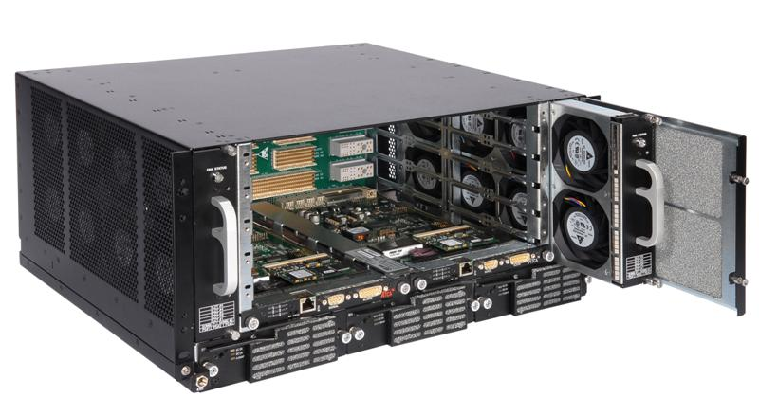
Sentry-ATCA
SERVICE DELIVERY PLATFORM
The Sentry-ATCA is a High-Performance Services Delivery Platform based on a 1-GbE and 10-GbE layer 2/3 Switch. The 10/100/1000 and 10 Gigabit Ethernet Ports are all wire-speed, non-blocking.
REDUNDANCY FEATURES FOR 5x9s HIGH AVAILABILITY The Sentry-ATCA is designed for critical environments. Redundancy is inherent in the core design, including power, control and connectivity.
ONE BOX SOLUTION
The Sentry-ATCA is the only network appliance that can incorporate Switching, Routing, High Performance Servers, High Performance Storage and Encryption in a ONE BOX Solution.
This allows IT managers to drastically reduce their power and cooling budget and give 20 times (20X) performance over industry standard solutions.
The Sentry-ATCA is the first network appliance to be based on an NSA Approved EAL 6+ Secure Kernel RTOS. This one feature mitigates the issues of the product being hacked and the Manchurian effect.

Slide 11
Cyber Security Solutions
Sentry Software
Velocite® Offers two encryption solutions
A patent pending Re-Keying capability for
Data in Transmission over Networks – P3
Data at Rest encryption (HD storage) – S3

Slide 12
Velocite Systems
Data in Transmission Solution
Protected Point-to-Point
P3
The Protected Point-to-Point solution provides a continuously secure channel for data between connection points
Encryption keys are updated without closing the connection
This patent pending feature allows
keys to be changed frequently without detection by an outside observer
data sessions to proceed uninterrupted by a re-keying process
Eliminated human administration of keying operations

Slide 13
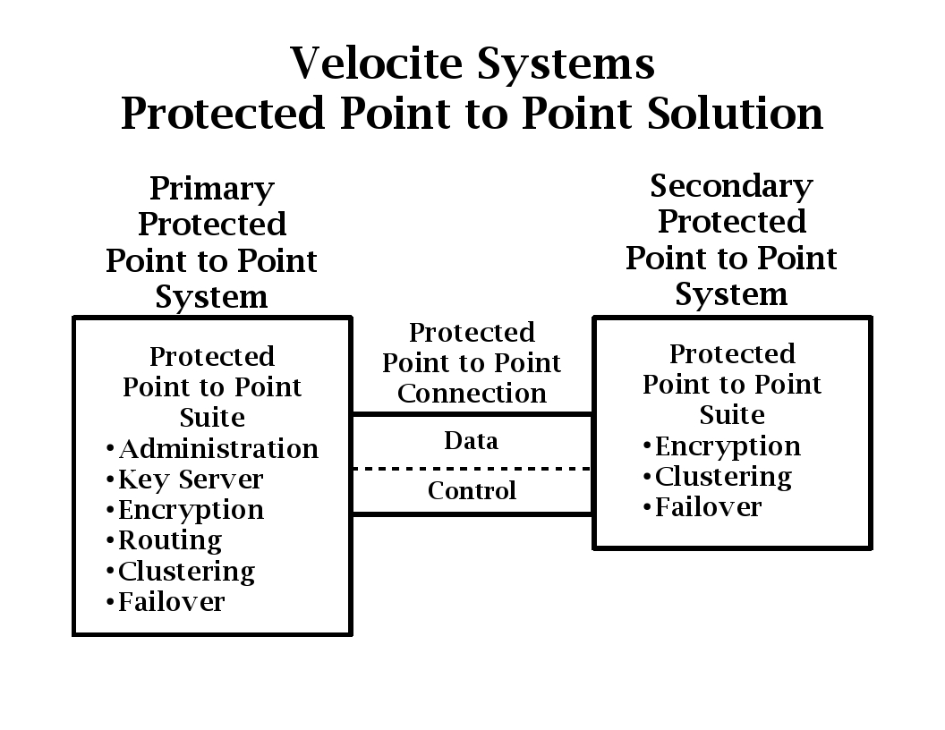
Velocite Systems
P3 Solution
Multiple secondary units with wired or wireless connection to Primary
Patent Pending

Slide 14
Velocite Systems
Data at Rest Encryption Solution
What is the Secure Storage Solution – S3?
The Secure Storage Solution
encrypts data at a file level on any hard drive device
maintains the encryption key separate from the data
assigns a unique key to each encrypted file
This prevents any stolen data from being decrypted

Slide 15
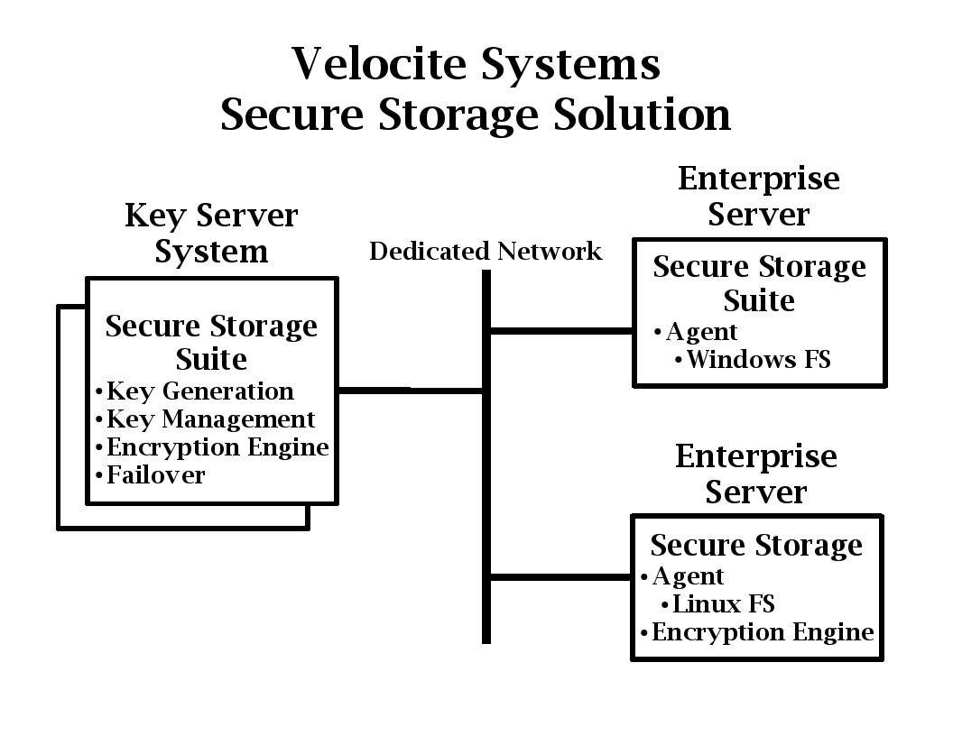
Velocite Systems
Secure Storage Solution

Slide 16
Velocite Systems
Secure Storage Solution
What is unique about the Secure Storage Solution?
Many data encryption solutions maintain the encryption key with the data which creates a strong possibility of decryption if the data is stolen
By assigning a unique key to each encrypted file, this possibility is further reduced

Slide 17
Contact Information
Velocite Systems
810 Cromwell Park Drive
Suite K
Glen Burnie, MD 21061
866-572-0015
Robert W. Cook
President
866-572-0015 ext. 105
Cell 443-618-7949
rcook@velocitesystems.com
Notes:
17

